Slide 1
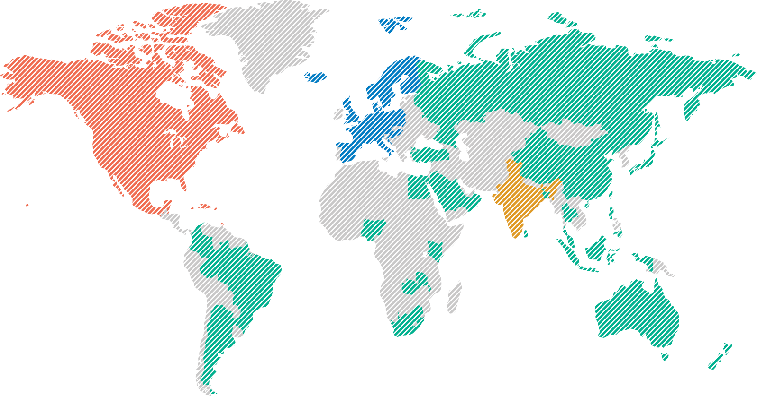
Global Company…
A global company with presence
in 50+ countries
North America
61.4%
Europe
25.2%
Rest of World
10.2%
India
3.2%

Slide 2



Infosys services
Experience
Digital Marketing
Digital Experience
Digital Commerce
Infosys Metaverse Foundry
Digital Interactions
Insight
Applied
Data Analytics
Innovate
Blockchain
Engineering Services
Internet of Things (IoT)
Accelerate
Enterprise Agile DevOps
Cloud – Infosys Cobalt
Microsoft Cloud Business
Salesforce
API Economy & Microservices
Digital Process Automation
Oracle
Service Experience Transformation
Application Modernization
Digital Supply Chain
SAP
Workplace Transformation
Assure
Cyber Security
Testing
Application Development and Maintenance
Application Development
Application Maintenance and Support
Domain Consulting
Technology Consulting

Slide 3








~ 800 yearly Hires from Revature in Digital technologies
1
#1 hirer of Revature Talents
7500 campus hires in North America
Highly governed relationship
Customized training for Infosys
>5 years of engagement

Slide 4










Why Infosys
Tools for Career Development
Recognized as Global
Top Employer
World class facilities for further learning
Consistent Revenue growth
of 13-15% per year
Diversified Industry focus
Quick career progression
(Power Programmers)
Industry standard benefits

Slide 5
Infosys: A True Leader in the Tech Space
Infosys Lex
Mobile platform only for employees
Learning upskilling & reskilling with any technology
Infosys has the most respected training for hires in your position in the world!
Previous onboards are now interviewing Revature associates
Infosys Flex
Mobile platform only for employees
Learning upskilling & reskilling with any technology
Infosys has the most respected training for hires in your position in the world!
Previous onboards are now interviewing Revature associates

Slide 6

Tips for Success
Schedule a 1:1 with your manager to set expectations
Keep an open mind
Lean into discomfort, trust the process and always aim to grow
Believe in yourself and work hard

Slide 7


Infosys Leadership Videos
Driving growth and value creation
Next in Digital

Slide 8

Q & A
Thank you for joining, we know you are just getting started!

